Slide 1

About Me: Jeremy Bergmann
About Me
Wife, Father of 3 Girls – 10, 6, Infant
Lifetime Learner/Teacher
BI&A Pro - Tech Entrepreneur
Hobbies/Passions
Analysis & Statistics
Sports – Playing, Analysis, Strategy
Reading, Exercise, Playing Cards

Slide 2

Background & Expertise
Professional Mission Statement
To provide Business Intelligence & Analytics (BI&A) Education, Consultative and Contracting Services that enable businesses to start and grow successful BI&A/Data Science programs.
Experience
10+ Years Business Intelligence & Analytics, Data Analysis, Data Mining, Market Research
BI Technologies, Data Visualization, BI Platform Design, Implementation & Self-Service
Education
BS Computer Science & MS Statistics University of Nebraska-Lincoln
Current - MBA/BIA Student at Creighton University
JB Analytics Consulting
Training: BI&A Software & Technology, Data Visualization, Business Insights & Analytics
Consulting: BI&A Strategy, Machine Learning/AI, Natural Language Processing, Platform Design & Architecture
Contracting: BI Platform Setup & Configuration, BI & Database Development, Advanced Analytics - ML/AI & NLP

Slide 3
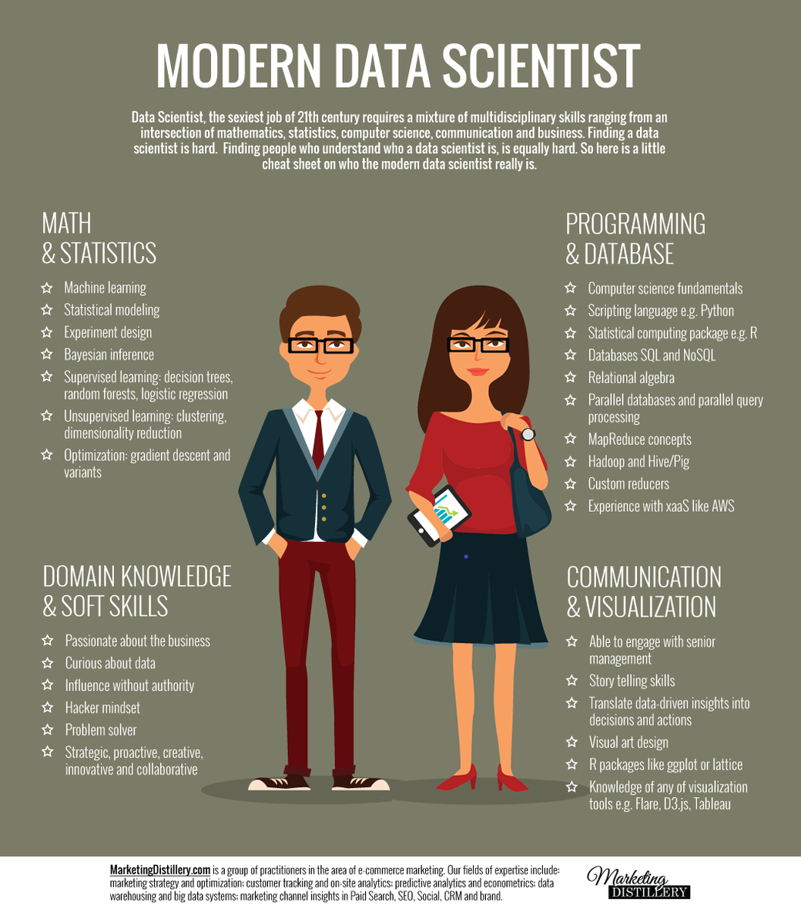
Data Science Philosophy
Combines Tech, Science, Psychology & Business
Data Science vs. Data Engineering
Diversity-of-thought & Soft Skills are keys to success!

